Slide 1


Slide 2
AIS Dynamic Defense Capture the Flag Exercise (Ru5tedBun1ons) 3.0
Assured Information Security, Inc.

Slide 3
Disclaimer
All opinions, statements, or illustrations expressed are mine and do not represent that of my employer or my employer’s customers or partners.

Slide 4
Agenda
AIS R&D: Virtual Machine Introspection (VMI)
Hackathon Capture The Flag Challenges

Slide 5
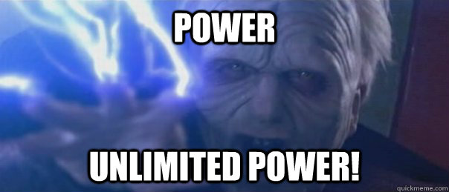
Background: Virtual Machine Introspection
Essentially provides ‘god-mode’ control over VMs and all from an architectural vantage point

Slide 6
Typical Uses of VMI
Defenses
Anti-Virus scans
Live guest patching
System Protection
Malware analysis
Software analysis
Reverse engineering

Slide 7
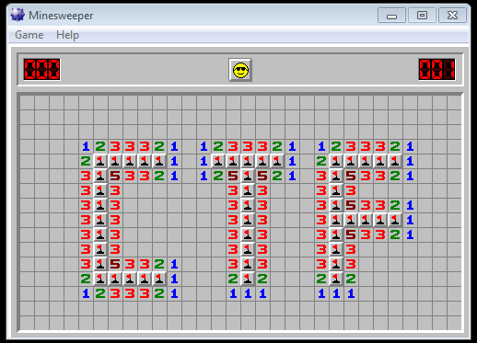

Slide 8
IntroVirt in the CTF
You will gain access to multiple VMs running on top of IntroVirt
IntroVirt will introduce inconsistencies, oddities, or abnormalities into some aspect of system operation
You will be given hints as to things you can do on these systems to find (or be presented with) the flag
You submit the flag and get points

Slide 9

On to the challenges!

Slide 10
CTF Challenges There will be a problem to solve. You have to find any working solution.

Slide 11
INFO? https://github.com/vix597/Ru5tedBun1ons Currently being updated. Will be ready at the start of the hackathon tomorrow morning. But the machines are up now. So ya know….

Slide 12
Overview:
Scoring
Level 1 (Easy): 100 points
Level 2 (Easy): 100 points
Level 3 (Medium): 200 points
Level 4 (Hard): 200 points

Slide 13
Thank You.

